Slide 1
Lecture 2 Linear Regression
Abrar Hasan
Lecturer
Dept. of Software Engineering

Slide 2
1
2
Table of contents
3
<
T
0
>
Linear Regression
Gradient Descent
Logistic Regression

Slide 3
1
Linear Regression
<
T
1
>

Slide 4
Linear Regression
<
T
1
>
Linear regression is a statistical technique used to model the relationship between a dependent variable (also called the target or response variable) and one or more independent variables (also called predictors or features)

Slide 5
Linear Regression
<
T
1
>
For example, you might want to predict a person's height (in inches) from his weight (in pounds).

Slide 6
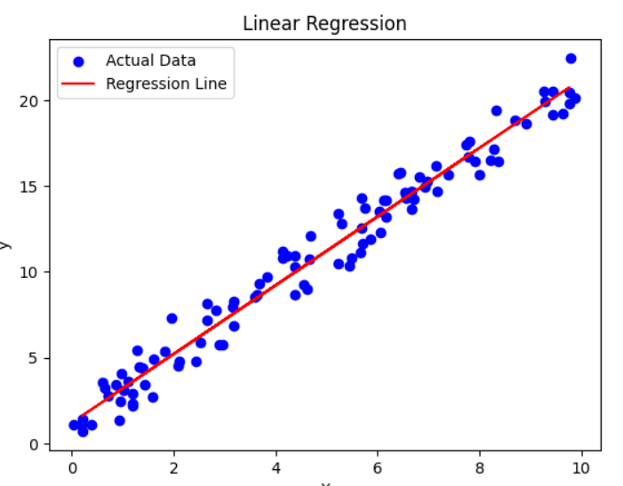
Linear Regression
<
T
1
>
y=β₀​+β₁​x+ϵ
Y = mX + C

Slide 7


Linear Regression
<
T
1
>
y=β₀​+β₁​x+ϵ
Y = mX + C

Slide 8
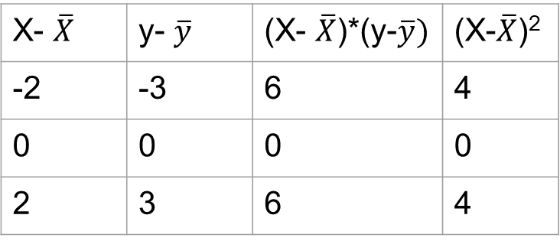


Linear Regression
<
T
1
>
Suppose You have to Build a linear regression model to predict the pizza prices from Following data
Pizza Size (x) | Pizza Price(y)
8 | 10
10 | 13
12 | 16
X- $\overline{X}$ | y- $\overline{y}$ | (X- $\overline{X}$)*(y-$\overline{y})$ | (X-$\overline{X}$)²
-2 | -3 | 6 | 4
0 | 0 | 0 | 0
2 | 3 | 6 | 4
$\overline{X}$ = $\frac{8+10+12}{3}$ = 10
$\overline{y}$ = $\frac{10+13+16}{3}$ = 13

Slide 9

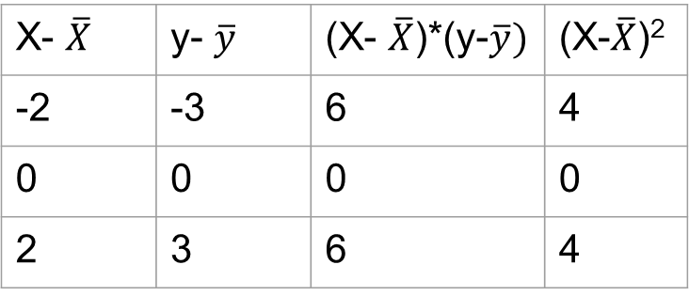

Linear Regression
<
T
1
>
Pizza Size (x) | Pizza Price(y)
8 | 10
10 | 13
12 | 16
X- $\overline{X}$ | y- $\overline{y}$ | (X- $\overline{X}$)*(y-$\overline{y})$ | (X-$\overline{X}$)²
-2 | -3 | 6 | 4
0 | 0 | 0 | 0
2 | 3 | 6 | 4
$=\frac{6+6}{4+4}=\frac{12}{8}=1.5$
$$=13 −\left(1.5 ∗10\right)=−2$$

Slide 10
Linear Regression
<
T
1
>
Y = 1.5X -2

Slide 11
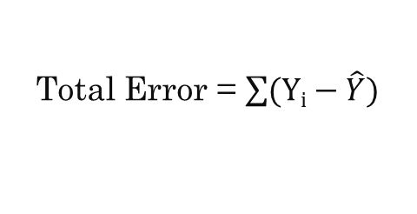


Linear Regression
<
T
1
>
Observed y-value
Real = Y
y
d₃
Predicted = $\hat{Y}$
d₁
d₂
Predicted y-value
Error d₁ = $Yi−\hat{Y}$
x
Total Error = $\sum{(Yi−\hat{Y})}$

Slide 12
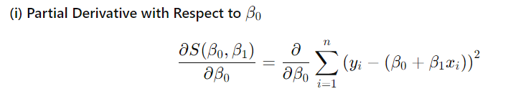
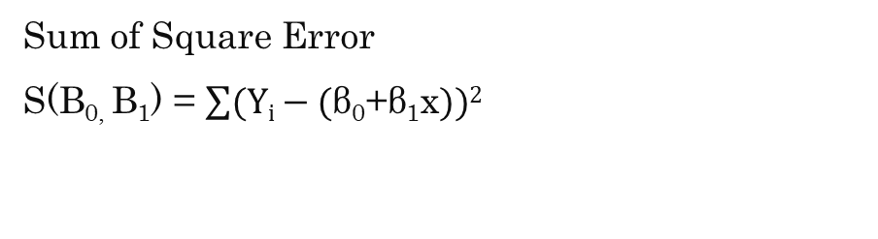
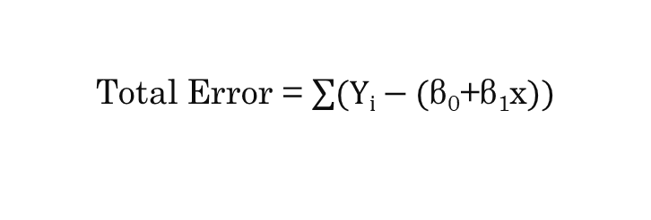
Linear Regression
<
T
1
>
Y = β₀​+β₁​x
Total Error = $\sum{(Yi−\text{(}\text{β}\text{0}\text{​+}\text{β}\text{1}\text{​}\text{x}))}$
Sum of Square Error
S(B_{0,} B₁) = $\sum{(Yi−\text{(}\text{β}\text{0}\text{​+}\text{β}\text{1}\text{​}\text{x}))2}$

Slide 13
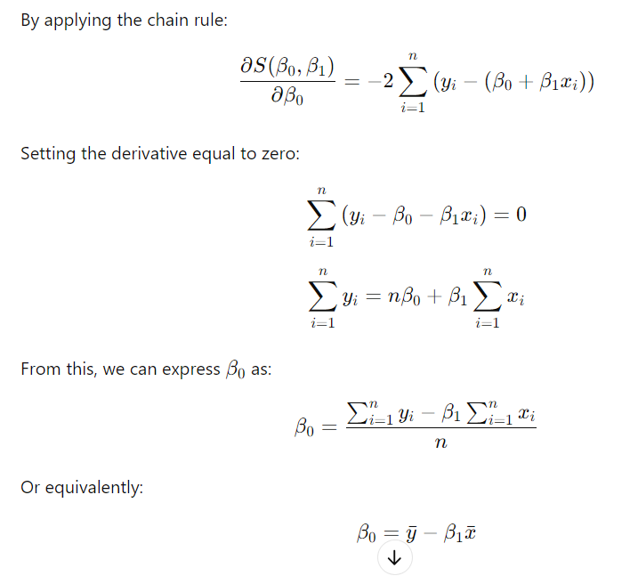
Linear Regression
<
T
1
>

Slide 14
Linear Regression
<
T
1
>

Slide 15
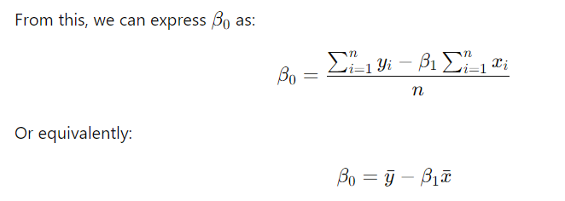
Linear Regression
<
T
1
>

Slide 16
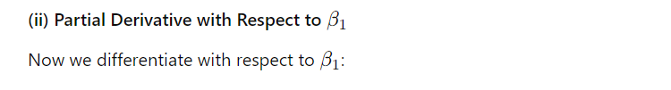
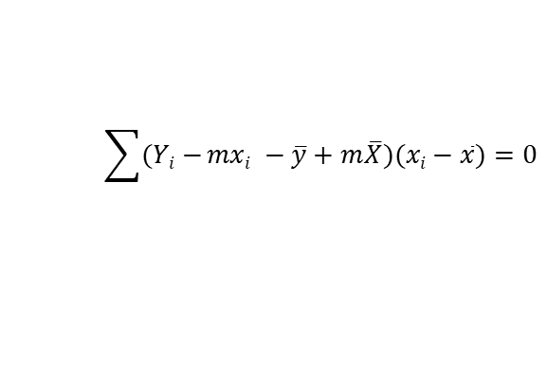
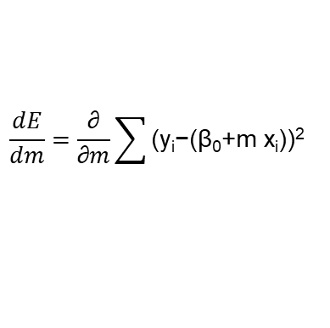
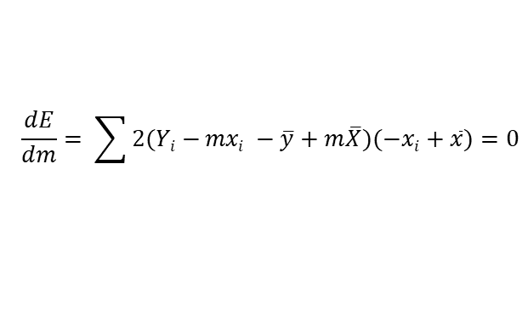
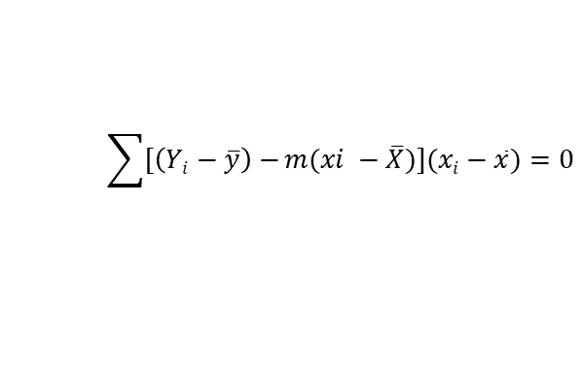
Linear Regression
<
T
1
>
$$\frac{dE}{dm}=\frac{\text{∂}}{\text{​∂}m}\sum{\text{(}\text{yi}\text{​−(}\text{β}\text{0}\text{​+}\text{m} \text{​}\text{x}\text{i}\text{​))}\text{2}}$$
$$\frac{dE}{dm}= \sum{2(Yi−}mxi −\overline{y}+m\overline{X})(−xi+\overline{x})=0$$
$$\sum{(Yi−}mxi −\overline{y}+m\overline{X})(xi−\overline{x})=0$$
$$\sum{[\left(Yi−\overline{y}\right)−}m(xi −\overline{X})](xi−\overline{x})=0$$

Slide 17
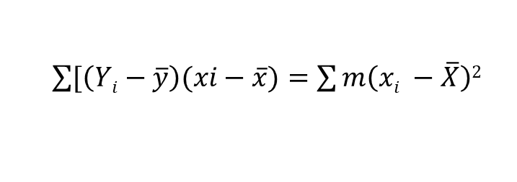
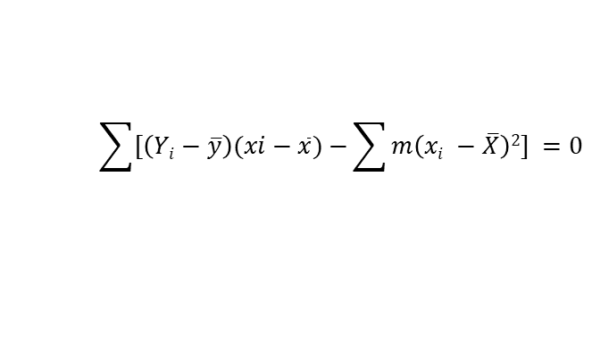
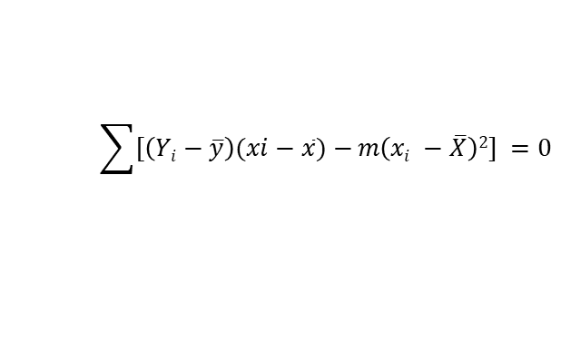
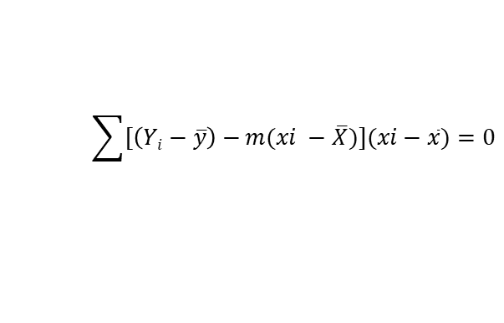

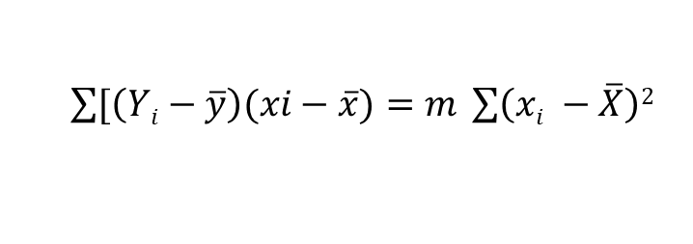
Linear Regression
<
T
1
>
$$\sum{[\left(Yi−\overline{y}\right)−}m(xi −\overline{X})](xi−\overline{x})=0$$
$$\sum{[\left(Yi−\overline{y}\right)(xi−\overline{x})−}m\left(xi −\overline{X}\right)2] =0$$
$$\sum{[\left(Yi−\overline{y}\right)(xi−\overline{x})−}\sum{m\left(xi −\overline{X}\right)2]} =0$$
$\sum{[\left(Yi−\overline{y}\right)(xi−\overline{x})}=$ $\sum{m\left(xi −\overline{X}\right)2}$
$\sum{[\left(Yi−\overline{y}\right)(xi−\overline{x})}=$ $m \sum{\left(xi −\overline{X}\right)2}$
$$m= \frac{\sum{[\left(Yi−\overline{y}\right)(xi−\overline{x})}}{\sum{\left(xi −\overline{X}\right)2}}$$

Slide 18
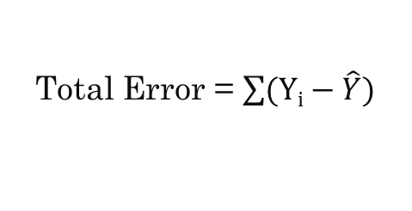
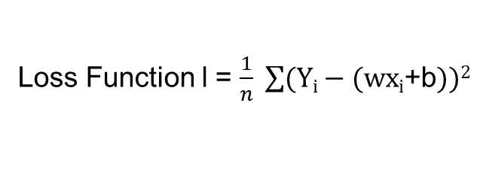
Gradient Descent
<
T
1
>
y = wx_{i} + b
Observed y-value
Total Error = $\sum{(Yi−\hat{Y})}$
y
d₃
Loss Function l = $\frac{1}{n} \sum{(Yi−\text{(}\text{wxi}\text{​+}\text{b}))2}$
d₁
d₂
Predicted y-value
x

Slide 19
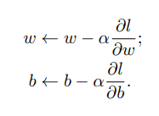
Gradient Descent
<
T
1
>
w ← 0 and b ← 0

Slide 20
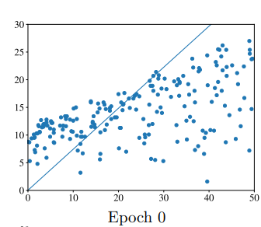
Gradient Descent
<
T
1
>

Slide 21
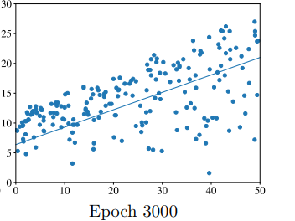
Gradient Descent
<
T
1
>

Slide 22
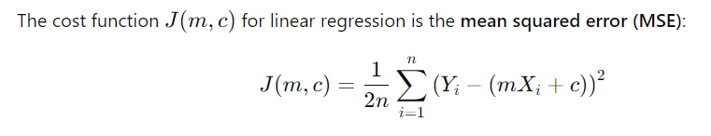
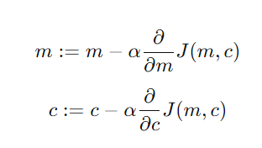
Gradient Descent
<
T
1
>

Slide 23
Gradient Descent
<
T
1
>
X | Y | Y(Predicted)
1 | 1 | 0
2 | 2 | 0
3 | 3 | 0
4 | 4 | 0
Y = mx + c
Let,
m =0
C= 0

Slide 24
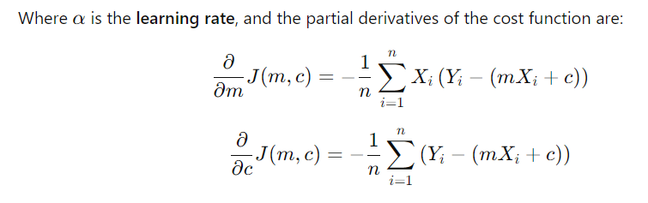

Gradient Descent
<
T
1
>

Slide 25
Gradient Descent
<
T
1
>

Slide 26
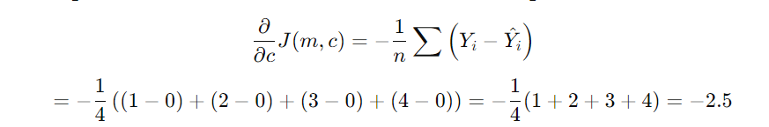
Gradient Descent
<
T
1
>

Slide 27
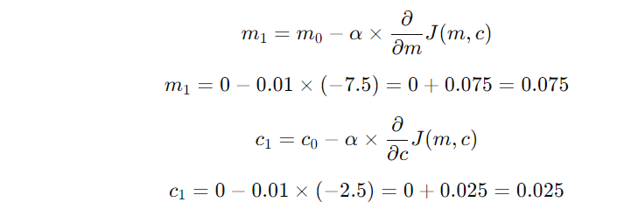
Gradient Descent
<
T
1
>

Slide 28
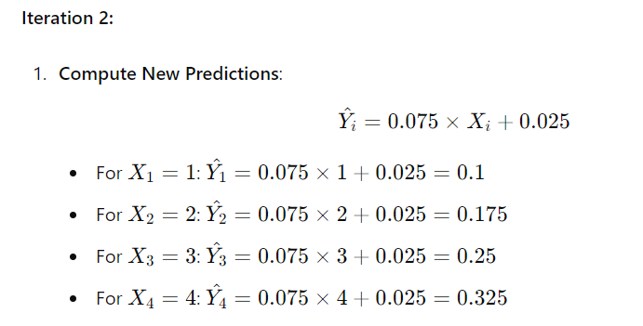
Gradient Descent
<
T
1
>

Slide 29
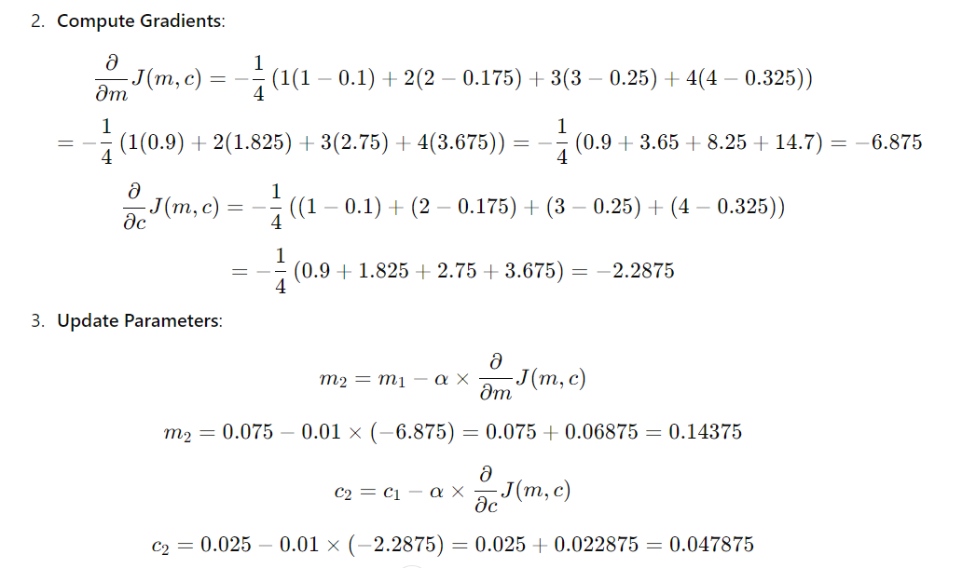
Gradient Descent
<
T
1
>

Slide 30
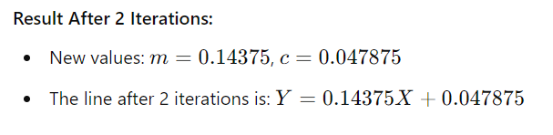
Gradient Descent
<
T
1
>

Slide 31
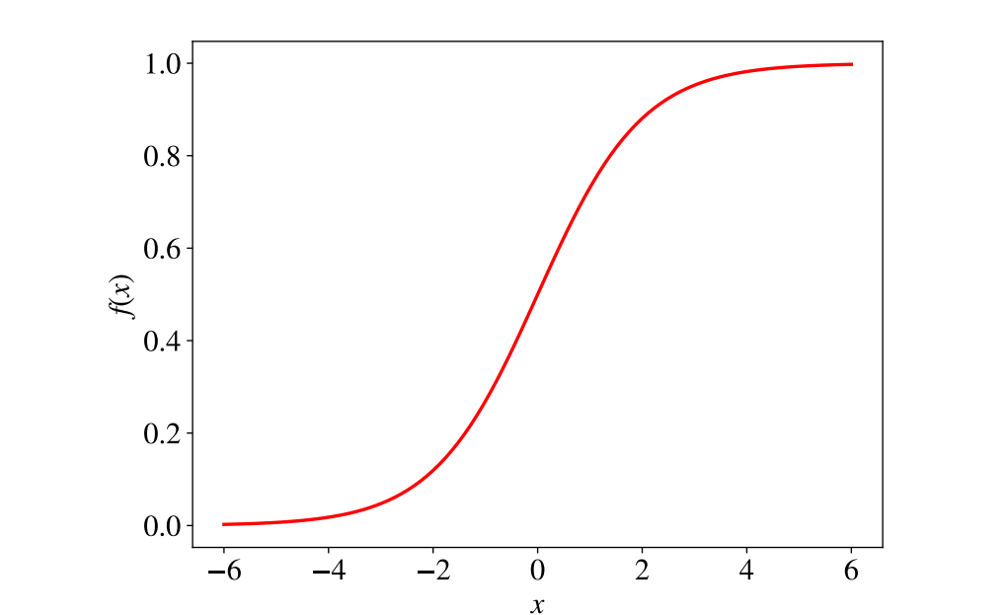
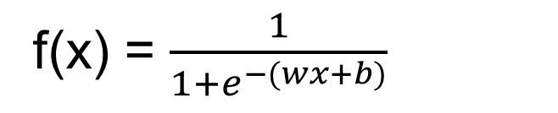
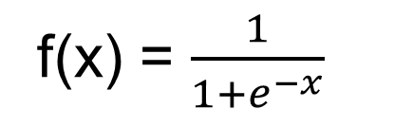
Logistic Regression
<
T
1
>
f(x) = $\frac{1}{1+e^{−x}}$
f(x) = $\frac{1}{1+e^{−(wx+b)}}$

Slide 32

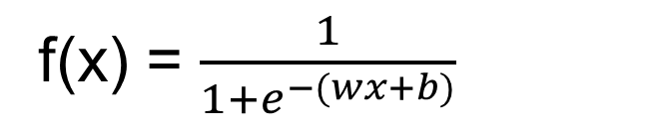
Logistic Regression
<
T
1
>
f(x) = $\frac{1}{1+e^{−(wx+b)}}$

Slide 33
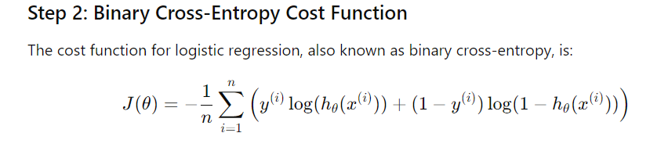
Logistic Regression
<
T
1
>

Slide 34
Logistic Regression
<
T
1
>

Slide 35
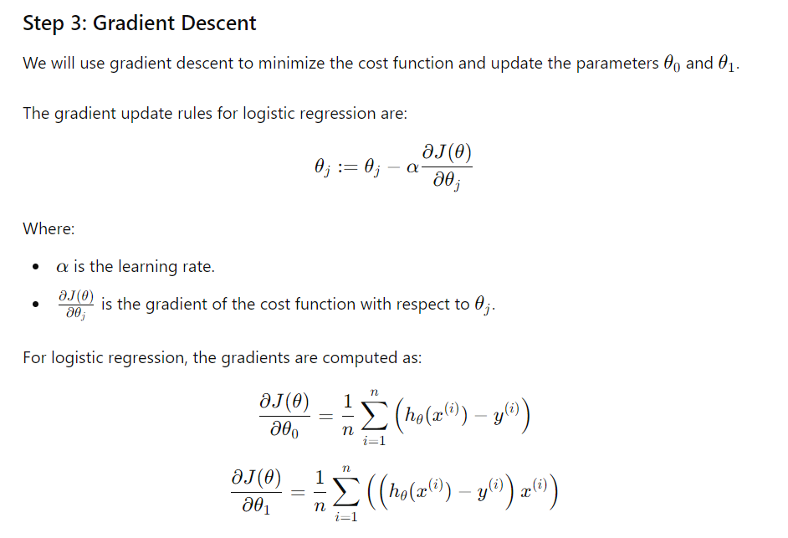
Logistic Regression
<
T
1
>

Slide 36
Logistic Regression
<
T
1
>
Hour Studied | Pass/ Fail | Y(Predicted)
2 | 0 | .5
3 | 0 | .5
5 | 1 | .5
7 | 1 | .5

Slide 37
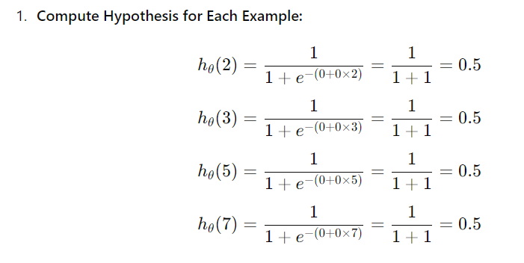
Logistic Regression
<
T
1
>

Slide 38
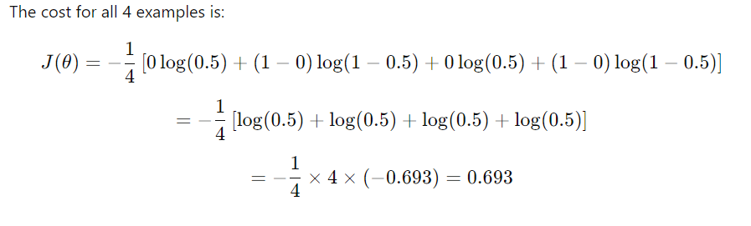
Logistic Regression
<
T
1
>

Slide 39
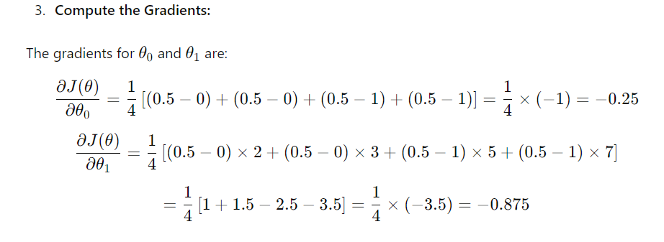
Logistic Regression
<
T
1
>

Slide 40
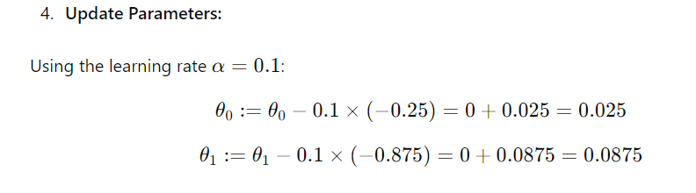
Logistic Regression
<
T
1
>

Slide 41
Thank You

